Slide 2
FACTORS OF CHANGE:
1.Socio-cultural- Social habits, Cultural differences.
2.Economical- Resources, Capital markets etc
3.Technological- Communication, Innovation.
4.Political Factors- Power , Dominance..
5.Legal- Various laws and legislative acts.

Slide 3
Social Environment
Social environment of business means all factors which affects business socially. Every business works in a society. So societies’ different factors like family, educational institutions and religion affects business.
It includes the culture that the individual was educated or lives in, and the people with whom they interact.

Slide 4
Cultural Environment
The cultural environment means an environment which affect the basic values , behaviours and preferences of the society-all of which have an effect on consumer marketing decisions.
Socio-cultural Environment
A set of beliefs, customs, practices and behaviour that exist within a population.
International companies often include an examination of the socio- cultural environment prior to entering their target markets.

Slide 5
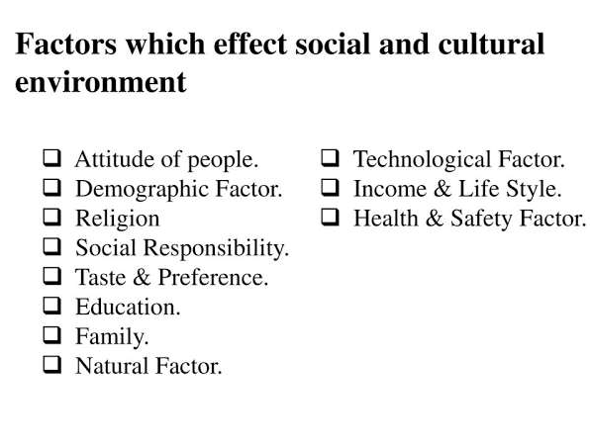

Slide 6
Economic Environment
The definition of economic environment is the environment in which businesses operate that is dependent on the sum total of economic factors.
Economic factors include income, employment, inflation, interest rates, consumer behaviour and distribution of wealth. All of the economic factors have effects on the economic environment, which in turn affects the business market.

Slide 7
Economic Environment
The Economic Environment factors have immediate and direct impact on the businessman so businessmen must scan the economic environment and take timely actions to deal with these environments.
Economic environment may put constraints and may offer opportunities to the businessman. After the new economic policy of 1991,lot of opportunities are offered to businessmen.

